Slide 1
Connecting Stata and Microsoft Word using StatTag for Collaborative Reproducibility
Stata Conference
July 12, 2019
Abigail S. Baldridge, MS
Presented to: Insert relevant presenter information Calibri 16pt
Presented on: Month day, Year
Presented by: Insert relevant presenter information here

Slide 2

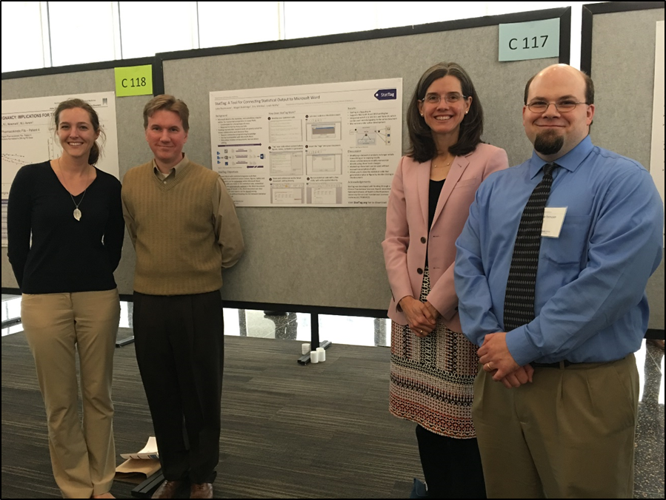


Acknowledgements and Disclosures
StatTag Team
Leah J. Welty, Project Director
Luke V. Rasmussen, Lead Software Developer
Eric W. Whitley, Software Developer
Development of StatTag was supported, in part, by the National Institutes of Health's National Center for Advancing Translational Sciences, Grant Number UL1TR001422
The content is solely the responsibility of the developers and does not necessarily represent the official views of the National Institutes of Health.

Slide 3
StatTag: A Reproducible Research Tool for Generating Dynamic Documents Using Microsoft Word and Stata
Stata Conference
July 29, 2016
Leah J. Welty, PhD
Luke V. Rasmussen, MS
Abigail S. Baldridge, MS
Presented to: Insert relevant presenter information Calibri 16pt
Presented on: Month day, Year
Presented by: Insert relevant presenter information here

Slide 4
Getting to know StatTag
Is it only for Word and Stata on Windows?
Circa July 29, 2016
 | Stata | SAS | R
Windows | Now | October 2016 | April 2017
Mac | Late 2016 | X | June 2017

Slide 5
Getting to know StatTag
Is it only for Word and Stata on Windows?
Circa July 29, 2016
 | Stata | SAS | R
Windows | Now | October 2016 | April 2017
Mac | Late 2016 | X | June 2017
Today
 | Stata | SAS | R | R Markdown | Python | Matlab
Windows | Now | Now | Now | Now | Soon! | Maybe?
Mac | Now | X | Now | Now | Soon! | Maybe?

Slide 6
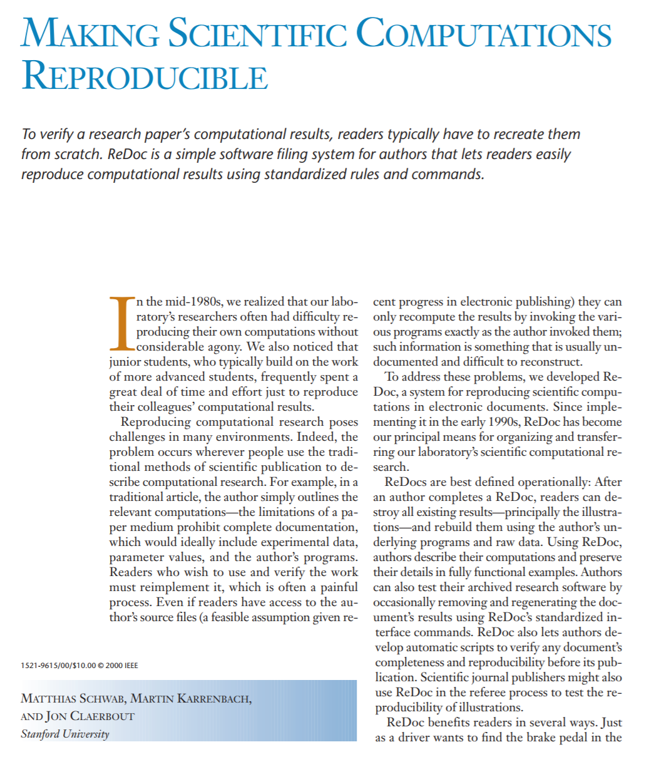
Brief history of reproducible research
The inconvenience of irreproducible research
“In the mid-1980s, we realized that our laboratory’s researchers often had difficulty reproducing their own computations without considerable agony.”
Notes:
reproducible research as a field or focus is rooted in the inconvenience of irreproducible research.
Jonathon Claerbout is recognized as a pioneer in reproducible research. He states … quote. I think many of us can think back on an occasion where this statement has applied to our own work, or at least to that of a colleague.

Slide 7
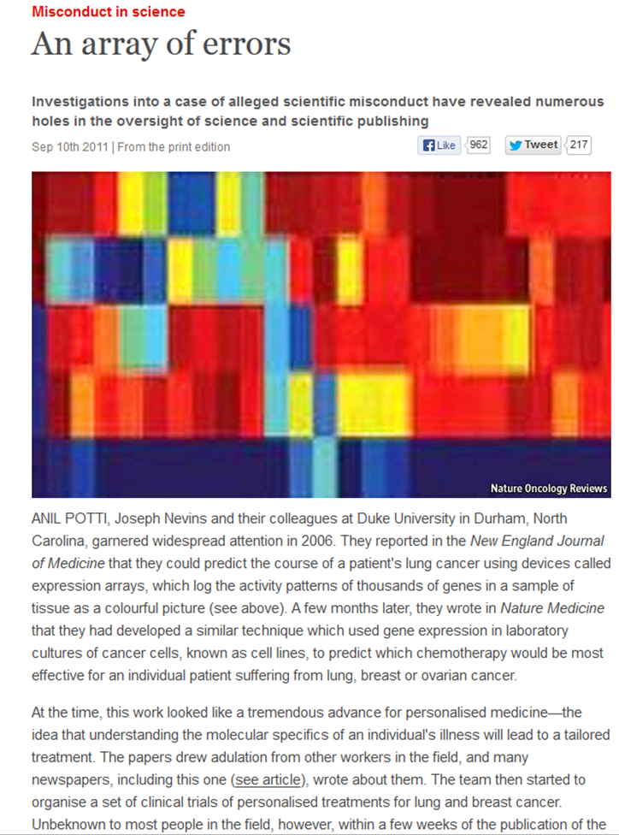
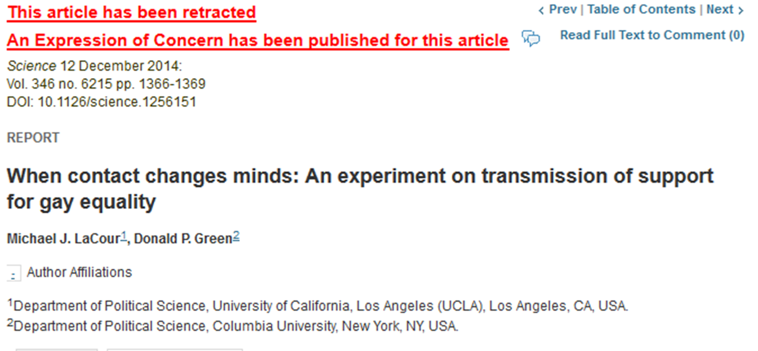
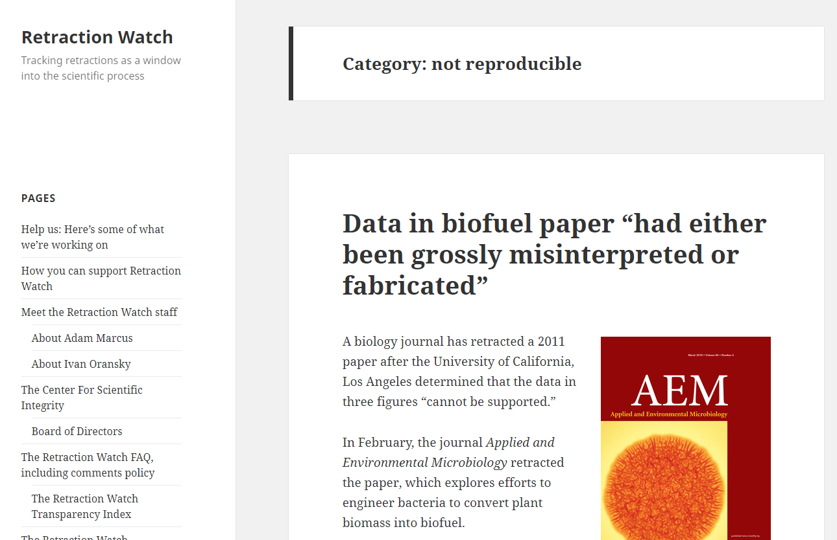
Brief history of reproducible research
The inconvenience of irreproducible research
Notes:
High profile events have accelerated the interest and adoption of reproducible research in the scientific community. Retraction Watch even has a category for “not reproducible”. This may mean that the data cannot be replicated, or that the results, using the exact same data cannot be reproduced using the exact same methods. As we heard yesterday from Dr. Goodman, reproducible research as a field is broad and encompasses many facets of the research enterprise. In this talk, I am focusing on the methodologic reproducibility, meaning that given the data and methods, an individual can reproduce the results of another’s work or their own prior work.

Slide 8
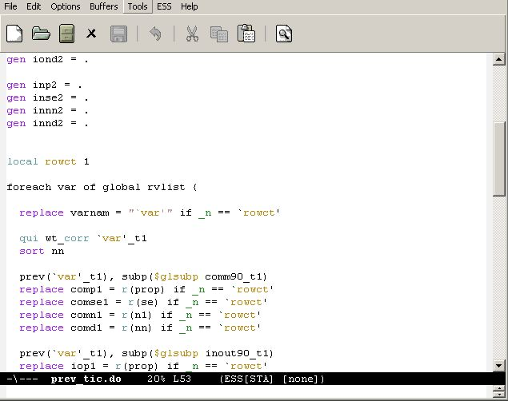
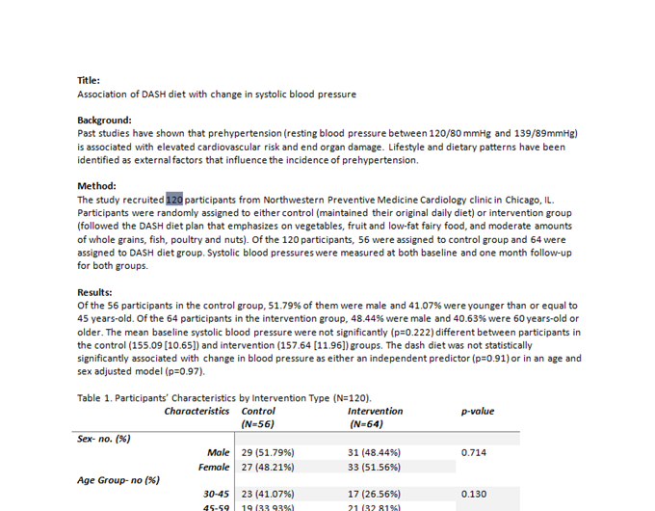
Dynamic Documents: A Cornerstone of Reproducibility
Why we love them
Numbers in document are updated automatically when data or models change.
Eliminates copying and pasting output.
Provides a link between a number in a manuscript and it’s provenance.
Notes:
The solution to this particular facet of reproducible research has long been generation of a dynamic document. A dynamic document blends text and analysis code in one plain text file. The plain text file is then rendered into a document or report. The dynamic document solves some challenges: bullets

Slide 9

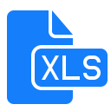










Tools for Generating Dynamic Documents
A reproducible research workflow
Methods and results are documented and reproducible
Markdown
knitR
ODS
Dyndoc
MarkDoc
Others …
evolving rapidly …
Notes:
There are numerous tools available for generating dynamic documents, and this field is rapidly evolving. The workflow generally involves pairing of raw data with code written in a statistical programming language with some package or software for dynamic documents. The output is a document that blends manuscript text with results, which can be in many forms.

Slide 10
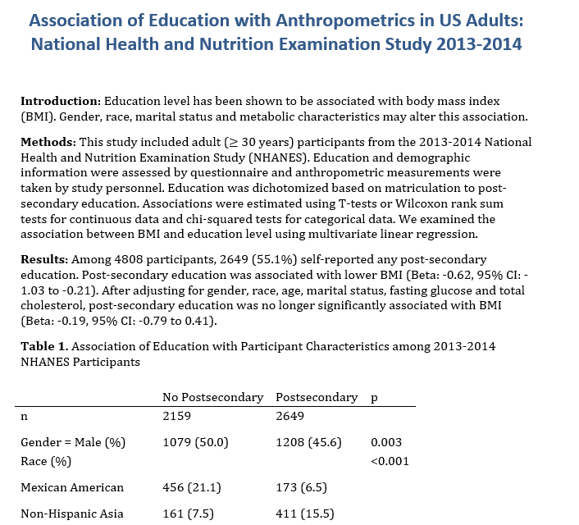
Dynamic Documents: A Cornerstone of Reproducibility
Why we love them
Everyone wants to write in Word
Manuscript preparation is a collaborative process
Notes:
I can use reproducible research tools and dynamic produce a beautiful reproducible Word document that blends text with results. However, there are some limitations to this. First of all, I do not work with anyone who is willing to write in this type of document. My collaborators are primarily doctors who want to write in Word. I can send this beautiful Word document to my collaborators, and what they return to me usually looks like

Slide 11

Dynamic Documents: A Cornerstone of Reproducibility
Why we love them
“All text…should be in one double-spaced electronic document (preferably a Word Doc)”
Everyone wants to write in Word
Manuscript preparation is a collaborative process
Notes:
I can use reproducible research tools and dynamic produce a beautiful reproducible Word document that blends text with results. However, there are some limitations to this. First of all, I do not work with anyone who is willing to write in this type of document. My collaborators are primarily doctors who want to write in Word. I can send this beautiful Word document to my collaborators, and what they return to me usually looks like

Slide 12

Dynamic Documents: A Cornerstone of Reproducibility
Why we love them
“For submission and review, please submit the manuscript as a Word document. Do not submit your manuscript in PDF format.”
Everyone wants to write in Word
Manuscript preparation is a collaborative process
Notes:
I can use reproducible research tools and dynamic produce a beautiful reproducible Word document that blends text with results. However, there are some limitations to this. First of all, I do not work with anyone who is willing to write in this type of document. My collaborators are primarily doctors who want to write in Word. I can send this beautiful Word document to my collaborators, and what they return to me usually looks like

Slide 13

Dynamic Documents: A Cornerstone of Reproducibility
Why we love them
“Science prefers to receive files in Word’s .docx format.”
Everyone wants to write in Word
Manuscript preparation is a collaborative process
Notes:
I can use reproducible research tools and dynamic produce a beautiful reproducible Word document that blends text with results. However, there are some limitations to this. First of all, I do not work with anyone who is willing to write in this type of document. My collaborators are primarily doctors who want to write in Word. I can send this beautiful Word document to my collaborators, and what they return to me usually looks like

Slide 14
Practical Limitations of Dynamic Documents
I send my collaborators the dynamic document….
Notes:
I can use reproducible research tools and dynamic produce a beautiful reproducible Word document that blends text with results. However, there are some limitations to this. First of all, I do not work with anyone who is willing to write in this type of document. My collaborators are primarily doctors who want to write in Word. I can send this beautiful Word document to my collaborators, and what they return to me usually looks like

Slide 15
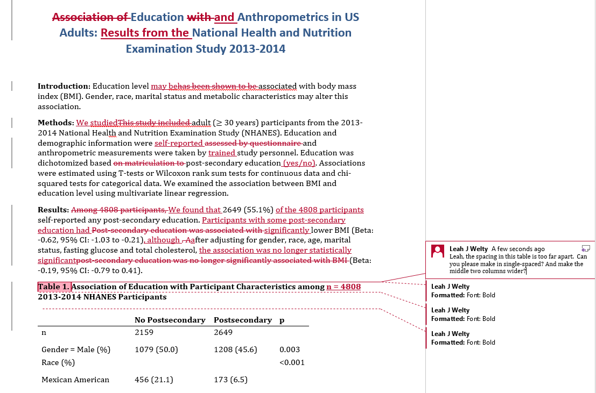
Practical Limitations of Dynamic Documents
…. They send back:
Two bad choices:
Continue in Word, and loose the dynamic nature of the document.
Re-enter all of their changes in my source file and re-render the document.
Notes:
This. I now have two choices, both of which are bad.

Slide 16

Tools for Generating Dynamic Documents
Limitations of the workflow
Methods and results are documented and reproducible
Markdown
knitR
ODS
Dyndoc
MarkDoc
Others …
Notes:
We have many tools available to take us from left to right. These tools however do not allow flexibility to move from right to left.

Slide 17

Tools for Generating Dynamic Documents
An alternative approach
Methods and results are documented and reproducible
Tracked changes and iterations do not break the process
Notes:
Herein is the motivation for StatTag. StatTag is a program that facilitates connection of statistical code with Microsoft Word. StatTag is used to identify code that output statistical results, either values, tables, figures or raw output and inserts those results within Word.

Slide 18


What makes StatTag different?
A different approach
StatTag is a free plug-in for Microsoft Word (Windows) and app (Mac)
StatTag creates links between the statistical output and the Word document
Can work separately on the code and the Word document but retain links
Software agnostic: connects Stata, SAS or R/R Markdown code and Word document
Can connect multiple code files to the same document

Slide 19

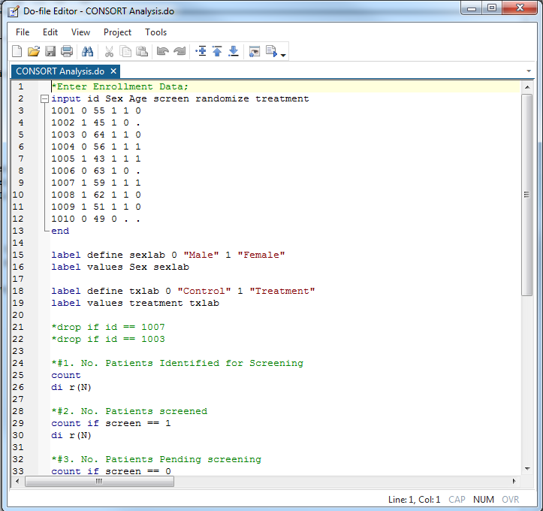
StatTag: How it Works
1. Write your code in your favorite native code editor.

Slide 20
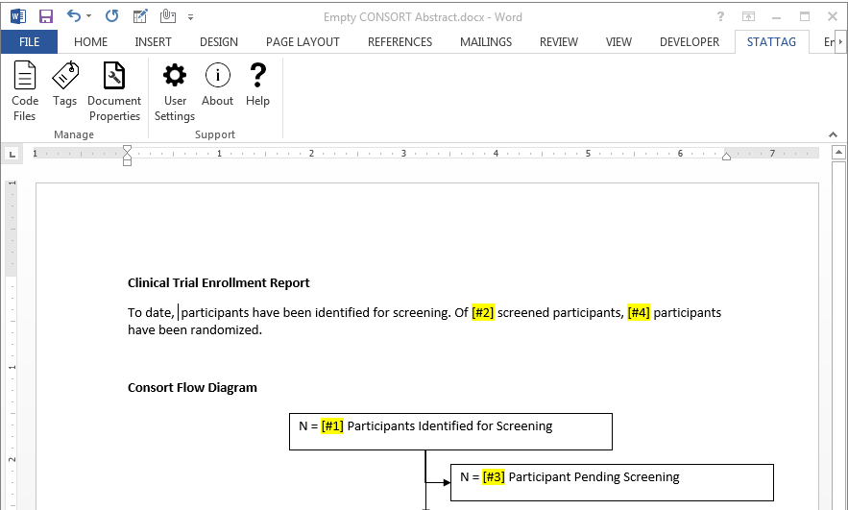
StatTag: How it Works
2. Open Word and write some or all of your text.

Slide 21
StatTag: How it Works
3. Use the StatTag Code Manager to connect your code file to the Word document.

Slide 22
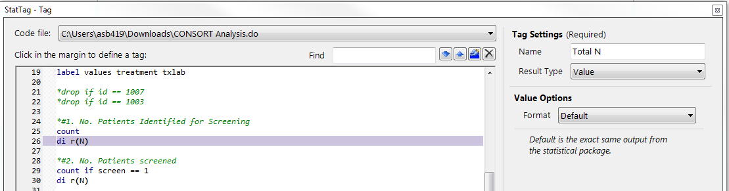
StatTag: How it Works
4. Use the StatTag Tag Manager to identify “tags” – portions of output that you want to insert.

Slide 23
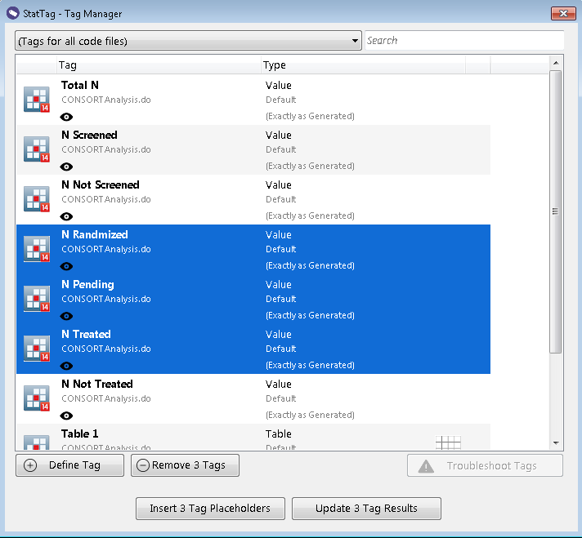
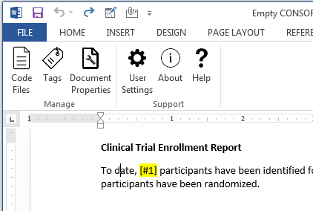
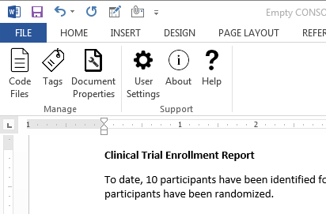
StatTag: How it Works
5. Use the StatTag Tag Manager to insert “tags” in your document.

Slide 24
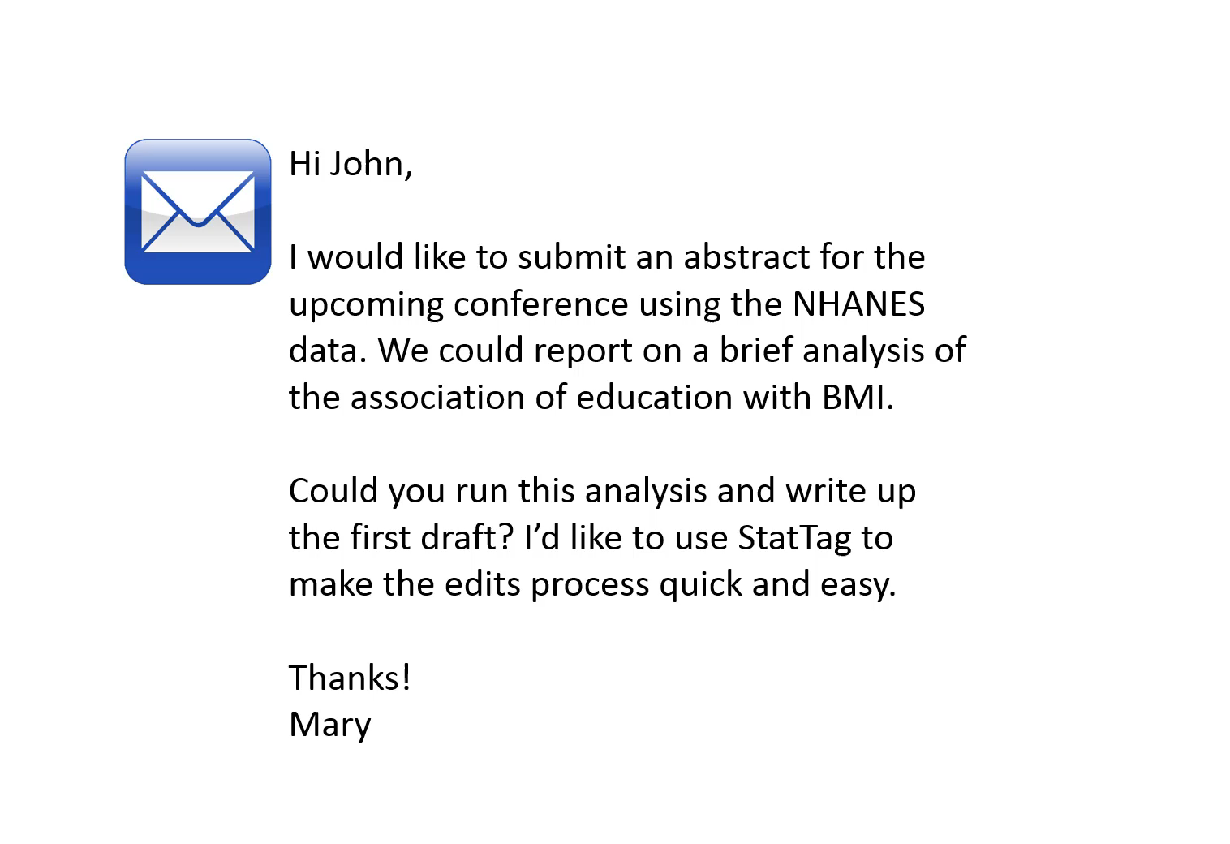
StatTag: How it Works

Slide 25
StatTag: How it Works
Video: https://www.youtube.com/watch?v=K3QwG4LB9a4

Slide 26
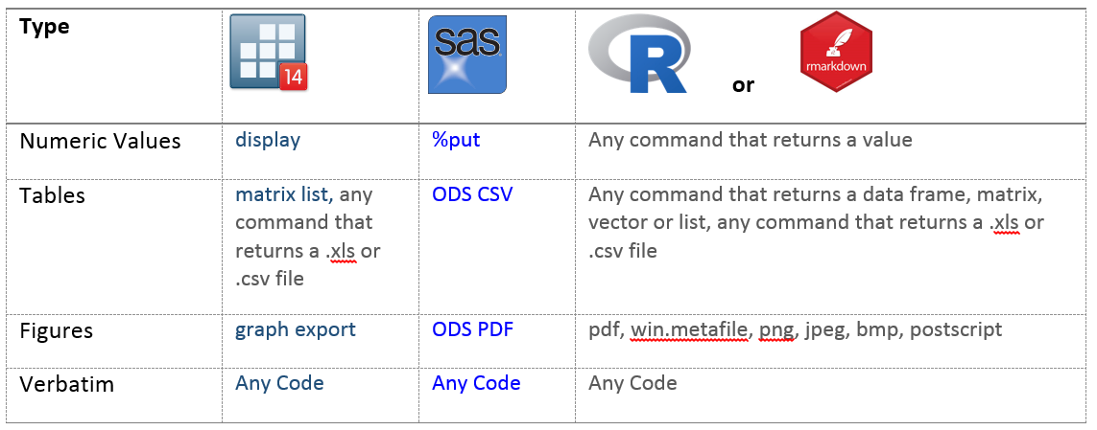
StatTag: Features
Recognizes different key words to identify results.

Slide 27
StatTag: Features
Recognizes different key words to identify results.
Wraps lines of code in commented text, ignored by the statistical program and used by StatTag to control insertion and update of results
**>>>ST:Value(Label=" ", Frequency="", Type="")
[code]
**<<<
**>>>ST:Table(Label="", Frequency="", Type="", AllowInvalid=True, Decimals=0, Thousands=False)
[code]
**<<<

Slide 28
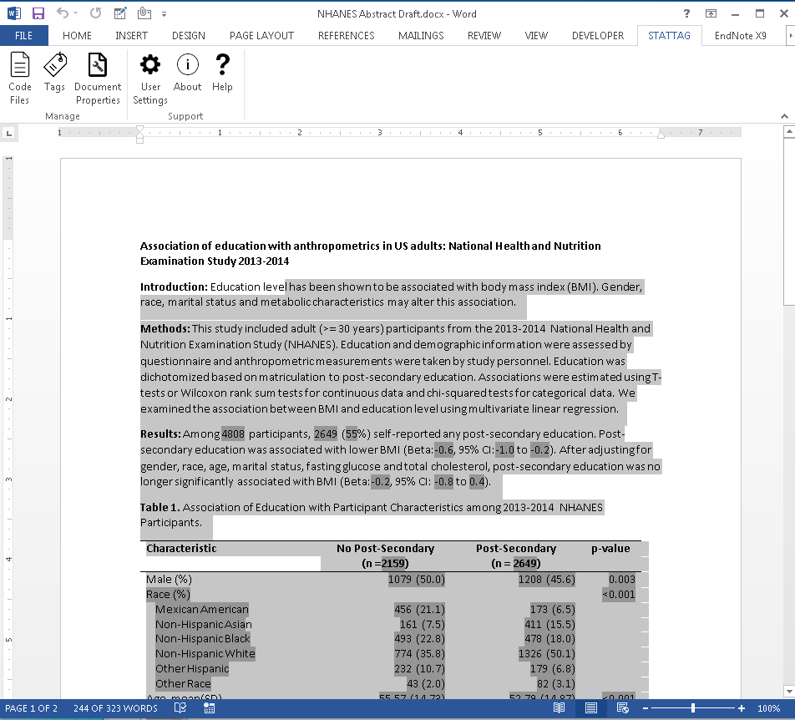
StatTag: Features
Recognizes different key words to identify results.
Wraps lines of code in commented text, ignored by the statistical program and used by StatTag to control insertion and update of results
Embedded tags appear as dark gray when highlighted

Slide 29
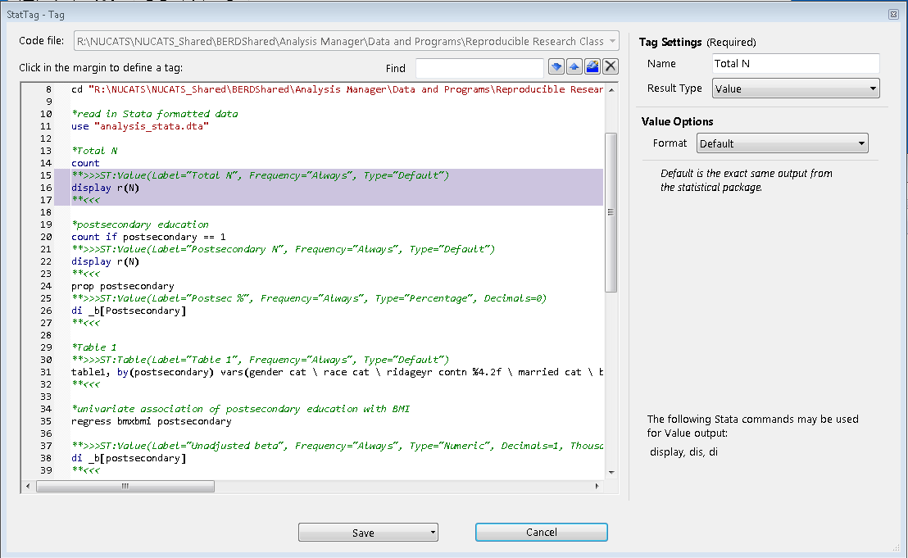
StatTag: Features
Recognizes different key words to identify results.
Wraps lines of code in commented text, ignored by the statistical program and used by StatTag to control insertion and update of results
Embedded tags appear as dark gray when highlighted
Double clicking on any tag opens the statistical code in the tag manager to view the provenance

Slide 30
Document Sharing & Data Security
How does StatTag work when sharing a Word document with collaborators?
If I have… | I can…
 | Review/edit manuscript text | View code associated with a tag | Insert or update a tag
Microsoft Word | ✓ | ✗ | ✗
StatTag and Stata/SAS/R code | ✓ | ✓ | ✗
Stata/SAS/R code and Data | ✓ | ✓ | ✓
Concerns over PHI, PII?
StatTag doesn’t store a copy of the data.
StatTag will eventually store a read-only copy of code files

Slide 31
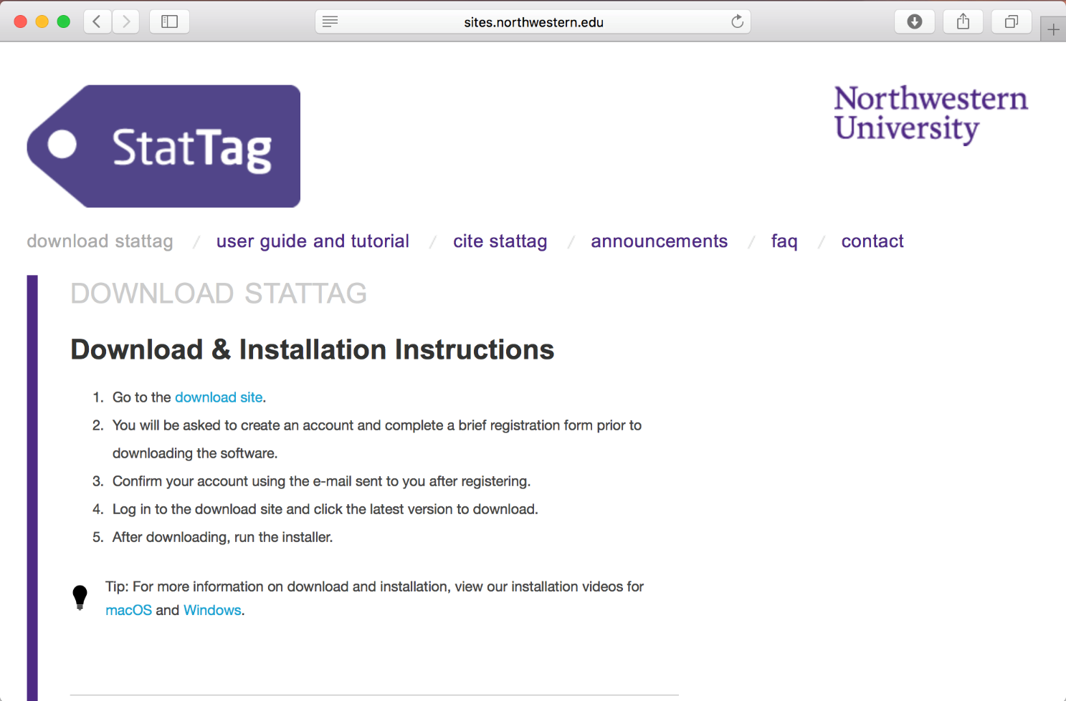
How to get StatTag
Download distributed versions from our website: stattag.org

Slide 32
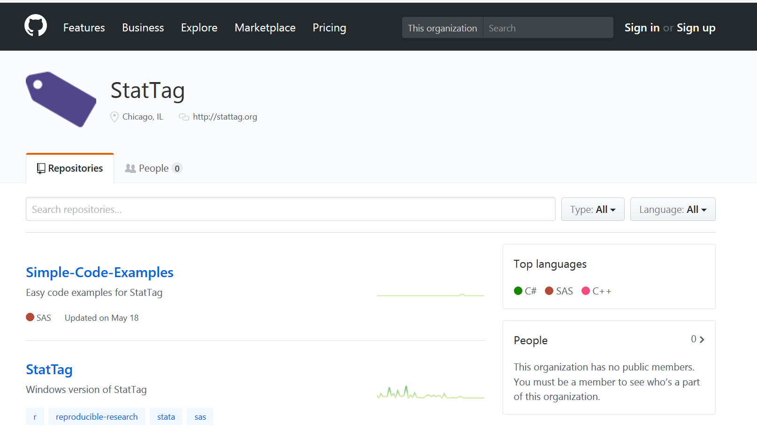
How to get StatTag
Download distributed versions from our website: stattag.org
Download the source files and contribute to development: github.com/StatTag

Slide 33
Questions?
Visit stattag.org for more information
Get involved! Contact us at stattag@northwestern.edu
Questions
Comments and suggestions
Volunteer to test new releases

Slide 34
Thank you!

